Slide 1
Drawing Tools
南开大学软件学院
王 靖

Slide 2
Goals
Introduce Viewports and Clipping
Window-viewport transformation
Classical clipping algorithm
Parametric Curves

Slide 3
World Windows and Viewports
y
y
W.t
V.t
W.l
W.r
V.b
V.l
V.r
x
x
W.b
World Window
View Port

Slide 4
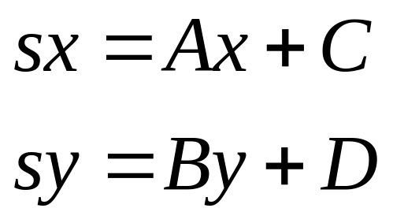
Window to the Viewport Mapping
x
sx
W.l
W.r
V.l
V.r

Slide 5
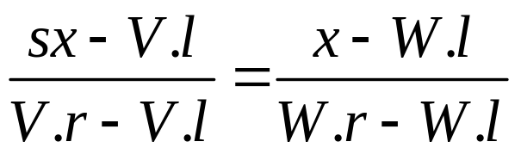
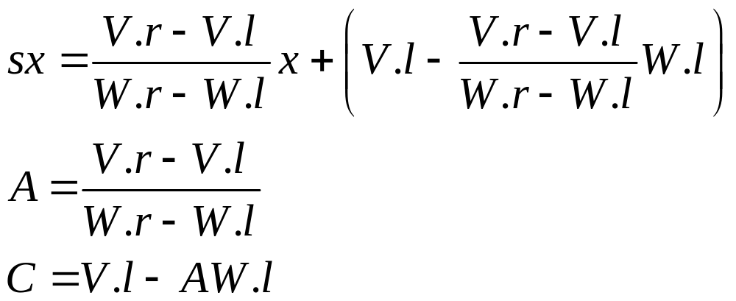
Window to the Viewport Mapping
x
sx
W.l
W.r
V.l
V.r

Slide 6
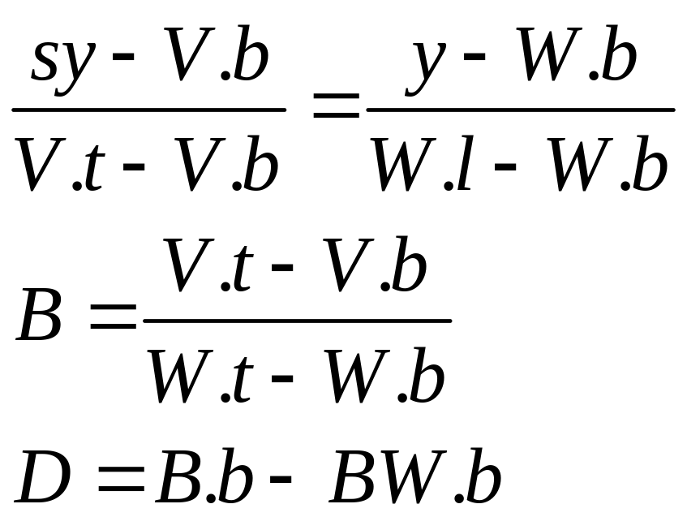
Window to the Viewport Mapping

Slide 7
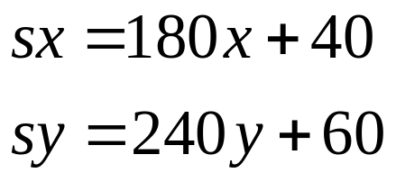
Window to the Viewport Mapping
y
300
1
2
60
1
40
400
x
A=180
C=40
B=240
D=60

Slide 8
Doing it in OpenGL
Void gluOrtho2D(GLdouble left, GLdouble right, GLdouble bottom, GLdouble top)
Void glViewport(Glint x, Glint y, Glint width, Glint height)
glMatrixMode(GL_PROJECTION)
glLoadIdentity();
gluOrtho2D(0.0,2.0,0.0,1.0); //sets the window
glViewport(40,60,360,240); //set the viewport

Slide 9
Setting the Window and Viewport Automatically
viewport
Screen window
R>W/H
World windwow
H
W/R
Aspect ratio: R
W

Slide 10
Setting the Window and Viewport Automatically
viewport
Screen window
R<W/H
World windwow
H
HR
Aspect ratio: R
W

Slide 11
Resizing the Screen Window
glutReshapeFUnc(myReshape); //specify the function called on a resize event
Void myReshape(GLsizei W,GLsizei H)
{ if(R>W/H) //use(global) window aspect ratio
if(R>W/H)
setViewport(0,W,0,W/R);
else
setViewport(0,H*R,0,H);
}

Slide 12
Clipping Lines
A
B
window
C
E
D
clipSegment(p1,p2,window)

Slide 13
Cohen-Sutherland Clipping
C
Window(W)
B
A
D
Trivial accept and Trivial reject

Slide 14
Cohen-Sutherland Clipping
P
To the left?
below?
Code for P: T T F F
Above ?
To the right?

Slide 15
Cohen-Sutherland Clipping
TTFF
FTFF
FTTF
TFFF
FFFF
FFTF
window
TFFT
FFFT
FFTT
LEFT ABOVE RIGHT BELOW
Trivial accept: Both code words are FFFF
Trivial reject: The code words have a T in the same position

Slide 16
Cohen-Sutherland Clipping
Divide-and-conquer strategy
Do
{
from the code words for p1 and p2
if (trival accept) return 1;
if (trival reject) return 0;
chop the line at the “next” window border; discard the “outside” part;
} while (1)

Slide 17
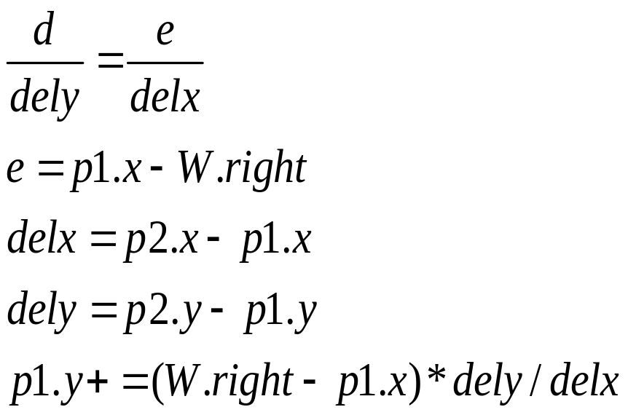
Cohen-Sutherland Clipping
y
P1
top
d
dely
e
P2
delx
bottom
left
right
x

Slide 18
Cohen-Sutherland Clipping
int clipSegment(Point2&p1, Point& p2, RealRect W)
{
do {
if (trivial accept) return 1;
if (trivial reject) return 0;
if( p1 is outside)
{
if(p1 is to the left) chop against the left edge
else if(p1 is to the right) chop agianst the right edge
else if (p1 is below) chop against the bottom edge
else if(p1 is above) chop against the top edge
}else //p2 is outside
{
if(p2 is to the left) chop against the left edge
else if(p2 is to the right) chop agianst the right edge
else if (p2 is below) chop against the bottom edge
else if(p2 is above) chop against the top edge
}
}while(1);
}

Slide 19
Cohen-Sutherland Clipping
P2
B
D
C
A
P1

Slide 20
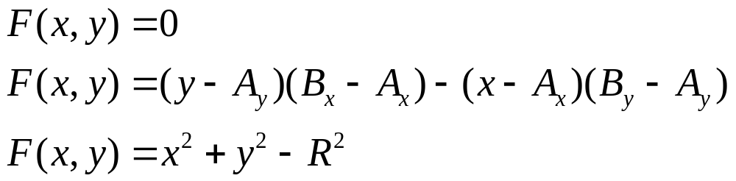
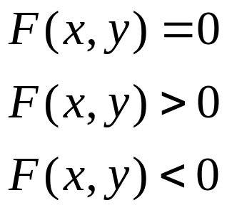
Parametric Form for a Curve
Implicit form
For all (x,y) on the curve
For all (x,y) outside the curve
For all(x,y) inside the curve

Slide 21
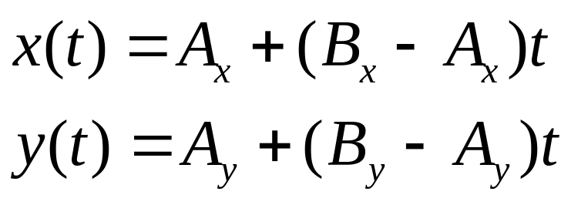
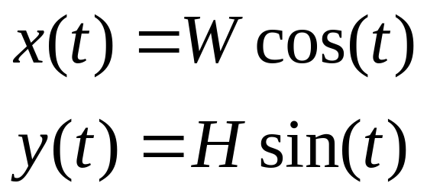
Parametric Form for a Curve
line
h
X(t),y(t)
Ellipse
c
c
w

Slide 22
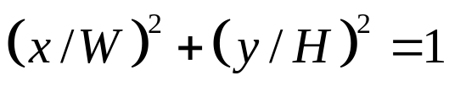
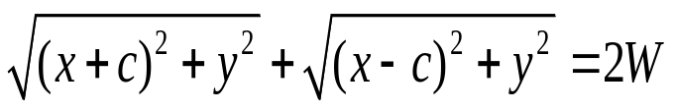
Parametric Form for a Curve
h
X(t),y(t)
c
c
w

Slide 23
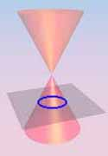
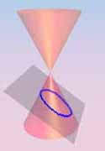
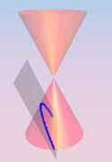
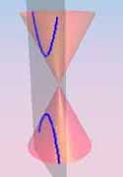
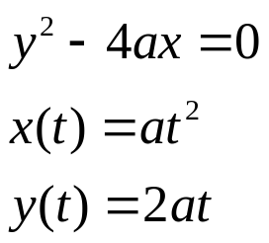
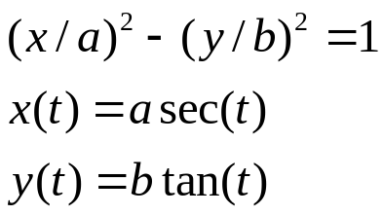
Parametric Form for a Curve
circle
Ellipse
Parabola
Hyperbola

Slide 24
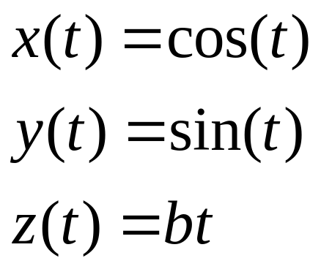
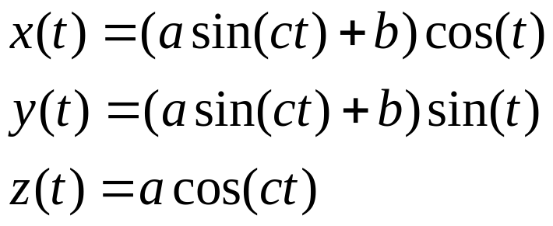
3D Curves
The helix
The totoidal spiral

